Slide 1

SmartHarvester Project
A Cloud Based Agriculture Management System with AWS Integration

Slide 2
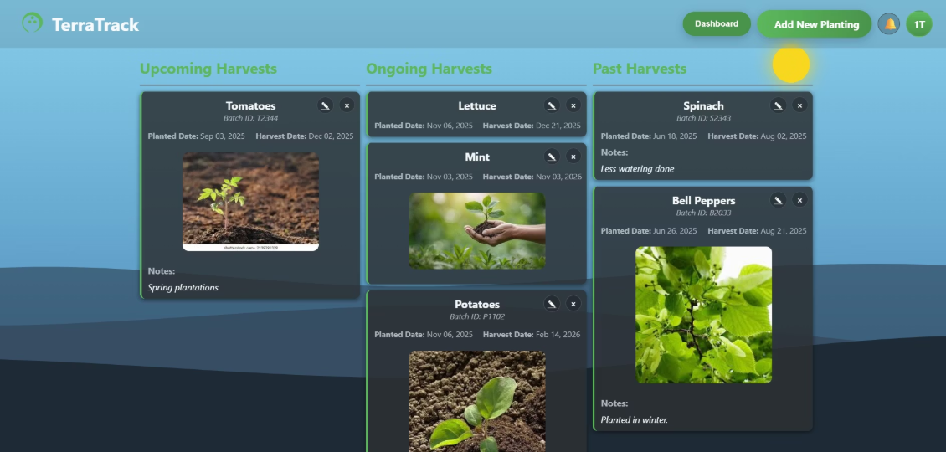
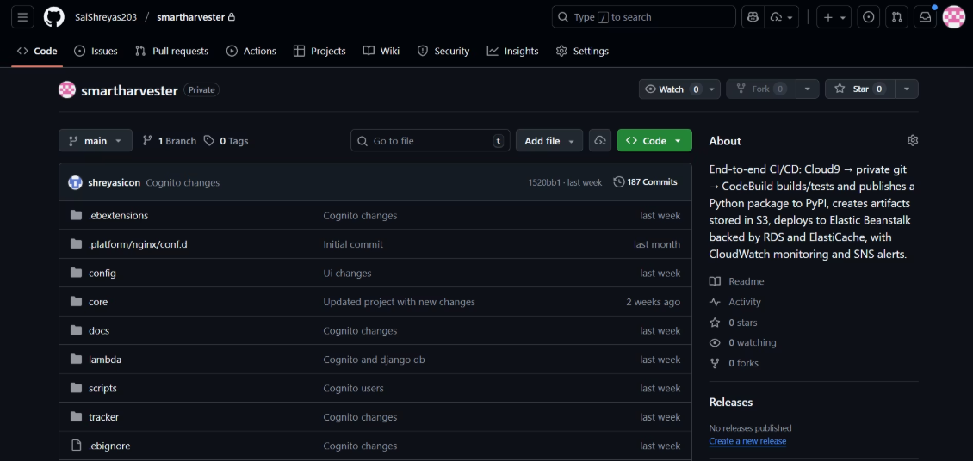

Application Overview & Access
SmartHarvester (Terratrack Core Web Application)
Deployed Application URL
Private GitHub Repository
https://3.235.196.246.nip.io
GitHub - SaiShreyas203/smartharvester: End-to-end CI/CD: Cloud9 → private git → CodeBuild builds/tests and publishes a Python package to PyPI, creates artifacts stored in S3, deploys to Elastic Beanst
Library URL
Application Domain: .nip.io
Agriculture and Forestry
SmartHarvester Cloud Platform & Terratrack Web Application
pip install smartharvest-plan-ghsai

Slide 3






Terratrack - Main Features
Planting Management: CRUD
Automated Care Plans
Smart Dashboard
Dual Authentication
Notification System
User Profile Management

Slide 4






AWS Cloud Services Integration
Key AWS Services Powering SmartHarvester
Cognito
DynamoDB
User Authentication & Management
Scalable NoSQL Database
S3
Lambda
Secure Object Storage
Serverless Compute Functions
EventBridge
SNS/SES
Serverless Event Bus
Notifications & Email Services
These services are integrated to manage compute, storage, authentication, messaging and DevOps workflows for performance and security for Terratrack.

Slide 5
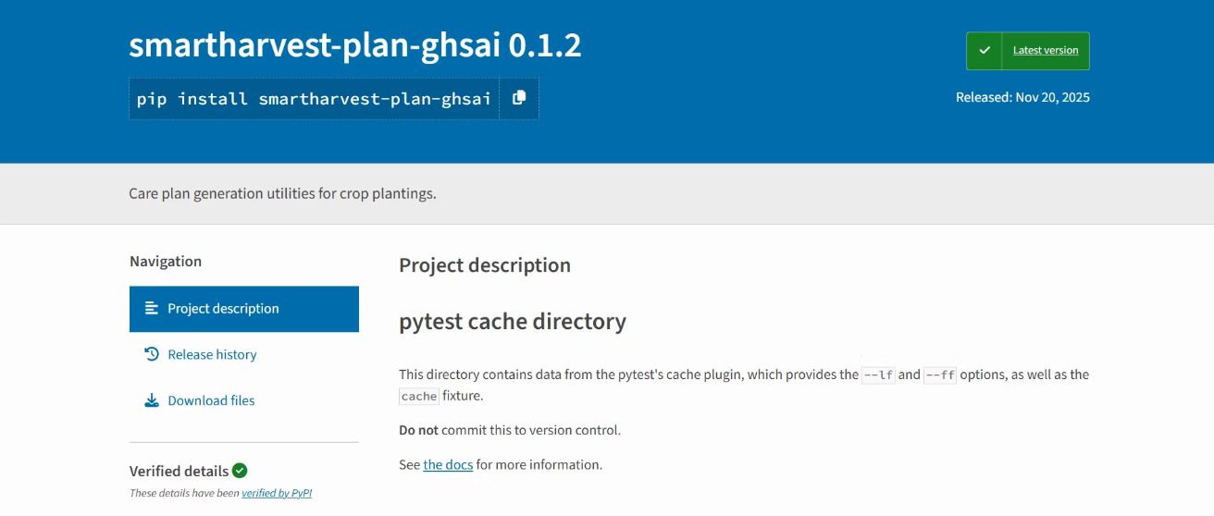

Custom Python Library - Plan Calculator
Library Name
smartharvest-plan-ghsai 0.1.2
Plant Care Plan Calculator (tracker/plan_calculator.py) - internally called
Purpose
Automates planting care schedule by calculating task due dates relative to planting date.
Key Functionalities
The library is automatically called when saving plantings and regenerates care plans on load, ensuring real-time updates.
Crop Name Normalization
Care Plan Calculation
Multi-Plant Support
Flexible Data Structure

Slide 6

SmartHarvester Architecture
The SmartHarvester architecture is designed for scalability and resilience, having a microserviced, event driven approach.
Data & Storage Services
User Interaction
DynamoDB, S3, RDS, SNS
Users easy access to app
Lambda + DynamoDB
SmartHarvester Architecture
GitHub → CodePipeline
User provisioning logic
Deploys code to EC2
Cognito Authentication
Django Application
Auth for users
Main app hosted
This hybrid design combines stateless application components with needed data and messaging layers, ensuring operations and secure data.

Slide 7
Technical Implementation Highlights
Web Framework
Database Models
Django 4.2 and Python 3.10
DynamoDB (NoSQL) and RDS PostgreSQL
Authentication
API Integration
JWT tokens (Cognito) and session based (Django), with JWKS caching
Boto3 SDK for AWS services, RESTful API endpoints and OAuth 2.0 authorization.
Deployment Stack
Security Features
EC2 hosting with Gunicorn WSGI, Nginx reverse proxy and Systemd services
IAM roles, VPC isolation, encrypted data, JWT verification and security groups

Slide 8
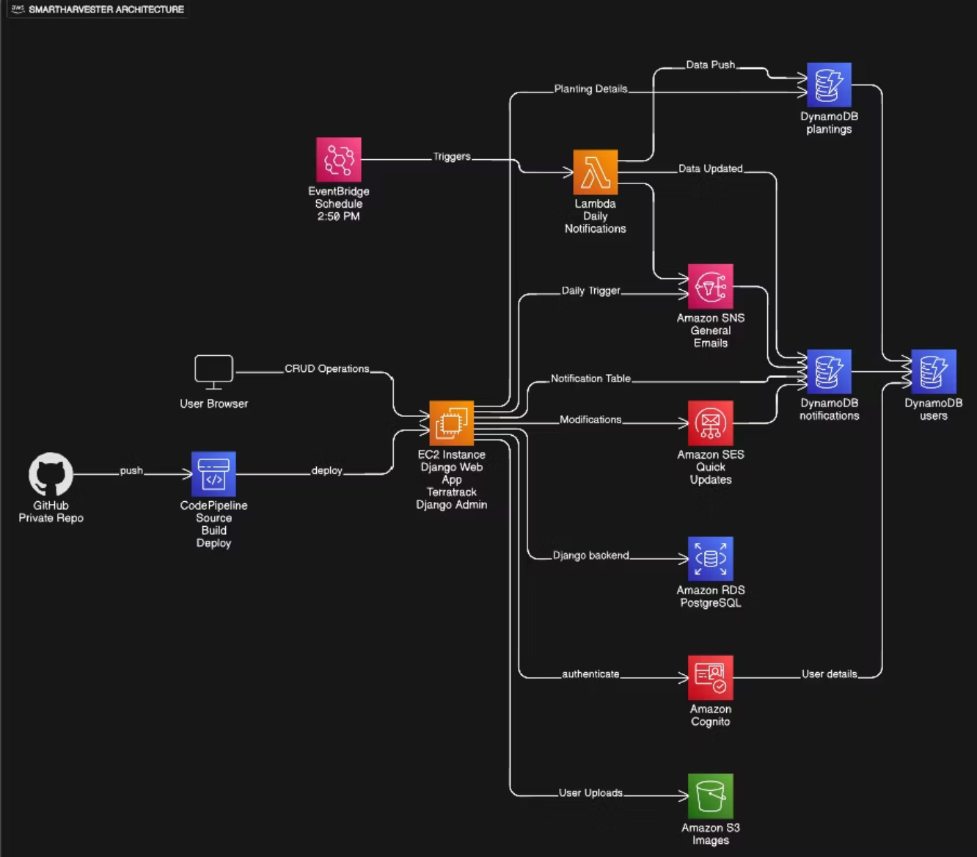
CI/CD & Monitoring
CI/CD Pipeline
Monitoring with CloudWatch
My automated pipeline ensures continuous integration and deployment
CloudWatch provides monitoring capabilities.
Source: GitHub repository as the primary source.
Logging: Centralized log collection for all services.
Build: Environment setup, tests and static file compilation.
Alarms: Configured to trigger alerts on any critical metrics.
Deploy: Automated deployment to EC2 instance.
Metrics: Real time performance metrics.

Slide 9












Project Summary & Key Achievements
SmartHarvester represents a powerful integration of modern web development with scalable cloud infra
AWS Integration
Dual Authentication
Scalable Architecture
Reusable Library
Event-Driven Notifications
Automated CI/CD
This project demonstrates a comprehensive understanding of cloud native development
Deployed Application
GitHub Repository
https://3.235.196.246.nip.io
https://github.com/SaiShreyas203/smartharvester

Slide 10

Thank
You!
(•‿•)

